Slide 1

Topic 2
Introduction to cost terms and concepts
Learning Objectives
Explain why it is important to understand the meaning of different cost terms
Define and illustrate a cost object
Explain the meaning of each of the key terms listed in this topic
Explain why in the short term some concepts and revenues are not relevant for decision making
Distinguish between job costing and process costing
Describe the three purposes for which cost information is required
drcetiner@gmail.com Dr. B. Gultekin Cetiner

Slide 2
Cost Objects
Cost Objects
• A cost object is any activity for which a separate measurement of cost is required (e.g.cost of making a product or providing a service).
• A cost collection system normally accounts for costs in two broad stages:
  1. Accumulates costs by classifying them into certain categories (e.g.labour,materials and overheads).
  2. Assigns costs to cost objects.
drcetiner@gmail.com Dr. B. Gultekin Cetiner

Slide 3
Direct and indirect costs
Direct and indirect costs
• Direct costs can be specifically and exclusively identified with a given cost object.
• Indirect costs cannot be specifically and exclusively identified with a given cost object.
• Indirect costs (i.e.overheads)are assigned to cost objects on the basis of cost allocations.
drcetiner@gmail.com Dr. B. Gultekin Cetiner

Slide 4
Direct and indirect costs
• Cost allocations = process of assigning costs to cost objects
that involve the use of surrogate, rather than direct measures.
• The distinction between direct and indirect costs depends on what is identified as the cost object.
drcetiner@gmail.com Dr. B. Gultekin Cetiner

Slide 5
Direct and indirect costs
Categories of Manufacturing Costs
• Traditional cost systems accumulate
product costs as follows:
  Direct materials xxx
  Direct labour xxx
  Prime cost xxx
  Manufacturing overhead xxx
  Total manufacturing cost xxx
  Non-manufacturing overheads xxx
  Total cost xxx
drcetiner@gmail.com Dr. B. Gultekin Cetiner

Slide 6
Direct and indirect costs
Categories of Manufacturing Costs
Direct materials cost consists of all those materials that can be identified with a specific product.
Indirect materials costs are related to the materials used for contributing to production of a certain product at an irregular period. E.g. Materials cost for Repairing a machine
Direct labour can be specifically traced to or identified with a particular product. e.g. Assembler working for fixing a product
Indirect labour costs are the cost which cannot be specifically identified for a certain product. E.g. Cost of accounting staff
drcetiner@gmail.com Dr. B. Gultekin Cetiner

Slide 7
Categories of Manufacturing Costs
Prime Cost refers to the direct costs of the product and consists of direct labour costs plus direct material costs plus any direct expenses. The cost of hiring a machine for producing a specific product is an example of direct expense.
Manufacturing overhead consists of all manufacturing costs other than Prime Costs.
drcetiner@gmail.com Dr. B. Gultekin Cetiner

Slide 8
Period and product costs
• Product costs are those that are attached to the products
and included in the stock (inventory valuation).
• Period costs are not attached to the product and included in
the inventory valuation.
drcetiner@gmail.com Dr. B. Gultekin Cetiner

Slide 9
Period and product costs
Example
Product costs = £100,000
Period costs = £80,000
50% of the output for the period is sold and there are no
opening inventories.
Production cost (product costs) 100,000
Less closing stock (50%) 50,000
Cost of goods sold (50%) 50,000
Period costs (100%) 80,000
Total costs recorded as an
expense for the period 130,000
drcetiner@gmail.com Dr. B. Gultekin Cetiner

Slide 10
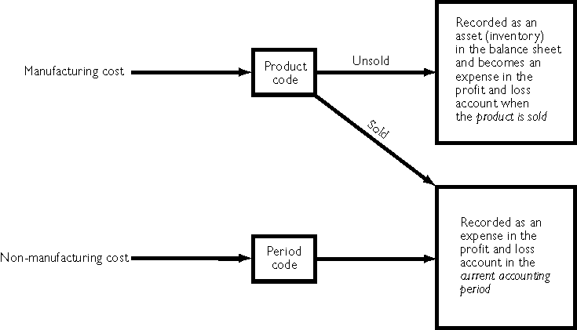
Treatment of product & period costs
Treatment of product & period costs
drcetiner@gmail.com Dr. B. Gultekin Cetiner

Slide 11
Classification by cost behaviour
Important to predict costs and revenues at different activity levels for many decisions.
Variable costs vary in direct proportion with activity.
Fixed costs remain constant over wide ranges of activity.
Semi-fixed costs are fixed within specified activity levels, but they eventually increase or decrease by some constant amount at critical activity levels.
Semi-variable costs include both a fixed and a variable component (e.g.telephone charges).
Note that the classification of costs depends on the time period involved.In the short term some costs are fixed,but in the long term all costs are variable.
drcetiner@gmail.com Dr. B. Gultekin Cetiner

Slide 12
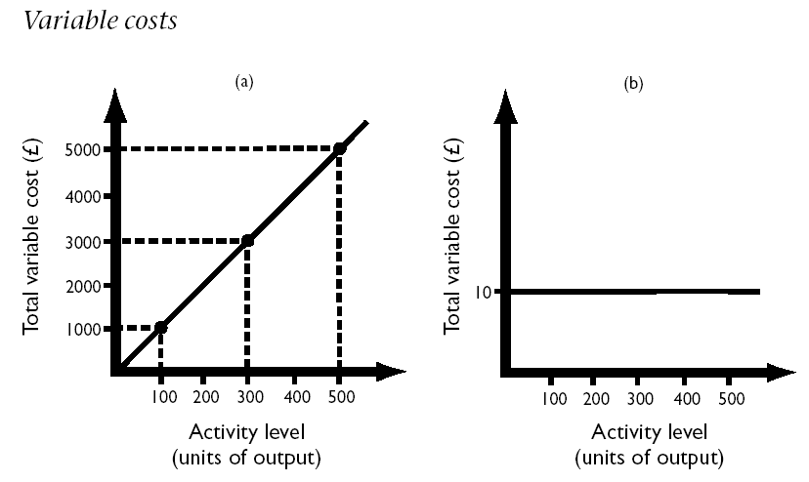
Classification by cost behaviour
Total Unit
drcetiner@gmail.com Dr. B. Gultekin Cetiner

Slide 13
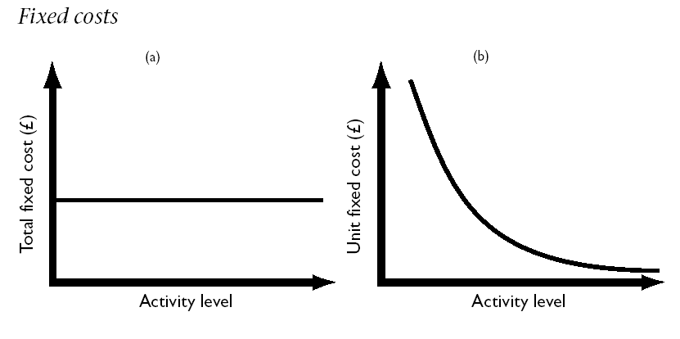
Classification by cost behaviour
Total Unit
drcetiner@gmail.com Dr. B. Gultekin Cetiner

Slide 14
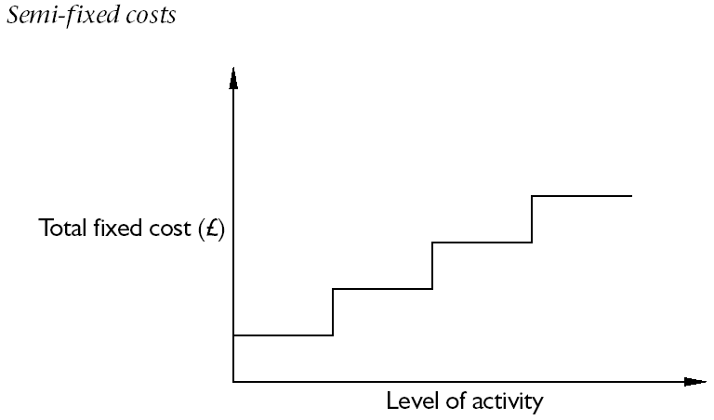
Classification by cost behaviour
drcetiner@gmail.com Dr. B. Gultekin Cetiner

Slide 15
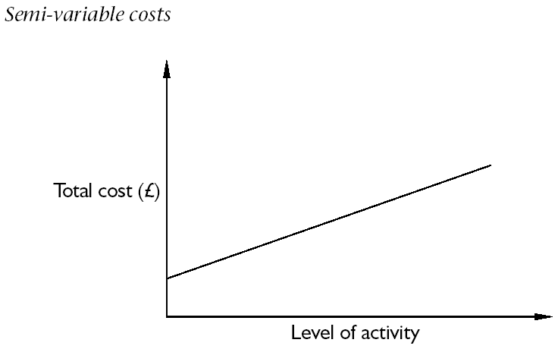
Classification by cost behaviour
drcetiner@gmail.com Dr. B. Gultekin Cetiner

Slide 16
Avoidable and unavoidable costs
• Avoidable costs are those costs that can be saved by not adopting a given alternative,whereas unavoidable costs cannot be saved.
• Avoidable/unavoidable costs are alternative terms sometimes used to describe relevant/irrelevant costs.
drcetiner@gmail.com Dr. B. Gultekin Cetiner

Slide 17
Relevant and irrelevant costs and revenues
• Relevant costs and revenues are those future costs and revenues that will be changed by a decision,whereas irrelevant costs and revenues will not be changed by a decision. Example; Take an alternative between using public transport or your car for going somewhere, insurance and road tax for your car are irrelevant for decision but the fair for public transport and petrol price for your car relevant.
drcetiner@gmail.com Dr. B. Gultekin Cetiner

Slide 18
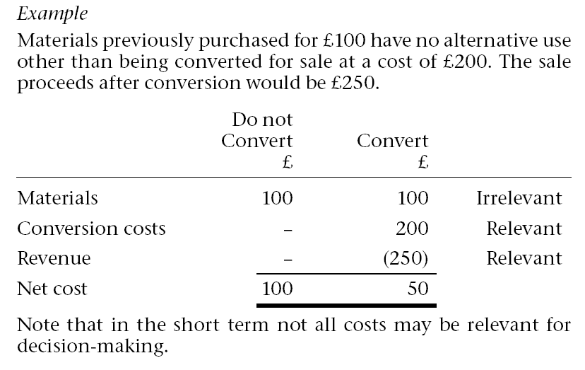
Relevant and irrelevant costs and revenues
drcetiner@gmail.com Dr. B. Gultekin Cetiner

Slide 19
Sunk costs & Opportunity costs
Sunk costs
• Sunk costs are the costs of resources already acquired and are unaffected by the choice between the various alternatives (e.g.depreciation).
• Sunk costs are irrelevant for decision-making.
Opportunity costs
• A cost that measures the opportunity that is lost or sacrificed when the choice of one course of action requires that an alternative course of action be given up.
Example
To produce product X requires that an order that yields £1 000 contribution to profits is rejected. The lost contribution of £1 000 represents the opportunity cost of producing product X.
drcetiner@gmail.com Dr. B. Gultekin Cetiner

Slide 20
Marginal and incremental costs/revenues
• Incremental costs and revenues are the additional costs/revenues from the production or sale of a group of additional units.
They are also known as differential costs or revenues
• Marginal cost/revenue represents the additional cost/revenue of one additional unit of output.
drcetiner@gmail.com Dr. B. Gultekin Cetiner

Slide 21
Job and process costing systems
• There are two types of costing systems that companies can adopt job and process costing systems.
• Job costing applies where each unit or batch of output of product or service is unique so that the cost of each unit must be calculated separately.
• Process costing relates to those situations where masses of identical units are produced so that it is unnecessary to assign costs to individual units of output.
• Cost per unit is assumed to be the average cost per unit of output.
• In practice these two systems represent extreme ends of a continuum.
drcetiner@gmail.com Dr. B. Gultekin Cetiner

Slide 22
Maintaining a cost database
A cost and management accounting system should generate information for meeting the following requirements:
Inventory valuation for internal and external profit measurement
Provide relevant information to help managers make better decisions
Provide information for planning,control and performance measurement
A database should be maintained, with costs appropriately coded and classified so that relevant information can be extracted to meet each of the above requirements.
drcetiner@gmail.com Dr. B. Gultekin Cetiner

Slide 23
Maintaining a cost database
Responsibility accounting: The costs and revenues must be traced to the individuals who are responsible for incurring them. This system is known as Responsibility accounting.
Responsibility accounting involves the creation of responsibility centres. A responsibility centre is an organization unit for whose performance a manager is held accountable.
drcetiner@gmail.com Dr. B. Gultekin Cetiner

